Slide 1
Deployment and Operations for Software Engineers 2nd Ed
Chapter 3 – Networking

Slide 2
Outline
Introduction
IP addresses
DNS
Ports
Bridged and NAT networks
TCP
Structuring your network

Slide 3
Messages
The only method of communication between two nodes in a distributed system is a message – a collection of bits passed from a sender to a recipient.
A message reflects an agreement between the sender and the recipient about the meaning of the bits.
A protocol is a standardized agreement about the meaning of the bits.
A portion of the boot process is connecting to a network adaptor. E.g. Wi-Fi or cable.

Slide 4
Layers of the internet
The internet is logically divided into four layers and each layer has a collection of protocols.
The ISO 7-layer model is (arguably) no longer used.
Layers | Typical Protocols
Application | HTTP, IMAP, LDAP, DHCP, FTP, MQTT
Transport | TCP, UDP, RSVP
Internet | IPv4, IPv6, ECN, IPsec
Datalink | Ethernet, ATM, DSL, L2TP

Slide 5
Multiple networks
Your device is on a local network that may use one type of protocol.
You wish to send a message to a device on another local network, possibly through a third network and possibly using a different protocol.

Slide 6
Connection terminology
Connection terminology
A gateway connects two networks and converts information, data or other communications between the protocols used by these two networks.
A firewall is a gateway that monitors incoming and outgoing network traffic and permits or blocks data packets. Firewalls are configured by specifying rules:
A proxy is a gateway that manages internet traffic on your behalf. A proxy server hides your IP address from the outside world.

Slide 7
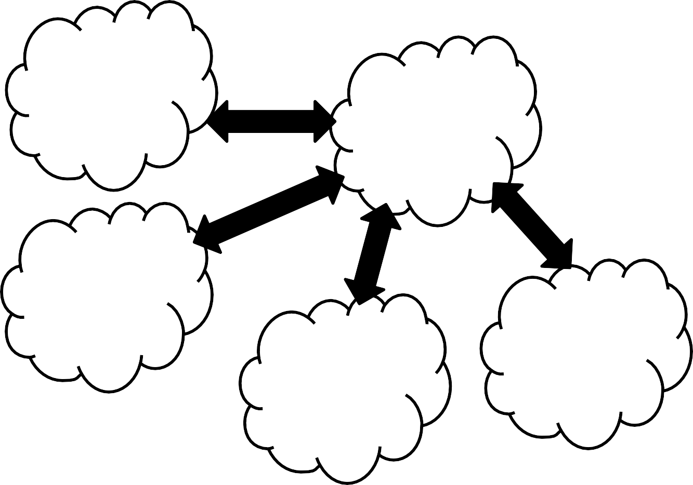
Connecting different types of networks
Cloud service provider
A gateway joins two different networks
Internet
Home
network
Large corporation network
Phone network

Slide 8
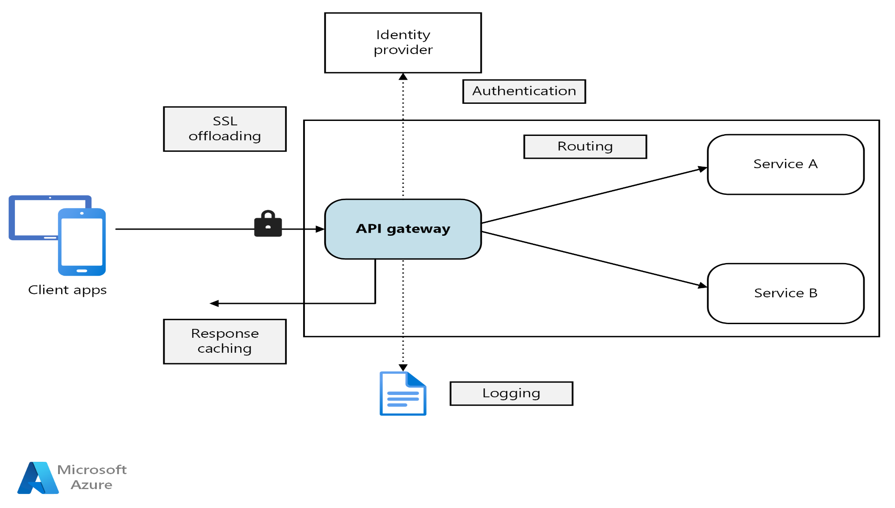
Use of gateway within cloud

Slide 9
Common misunderstandings about networks
The network is reliable.
Latency is zero.
Bandwidth is infinite.
The network is secure.
Technology does not change.
There is one administrator.
Transport cost is zero.
The network is homogeneous.

Slide 10
Discussion questions
What is the benefit of viewing the internet as a collection of layers?
Why would you use one protocol in a given layer instead of another?
What are the limitations of using messages as a communication mechanism?

Slide 11
Outline
Introduction
IP addresses
DNS
Ports
Bridged and NAT networks
TCP
Structuring your network

Slide 12
Internet Protocol (IP)
IP is a protocol for the internet layer in the four layer view of networks.
Two versions of IP
IPv4--32 bits
IPv6—128 bits
IPv6 standardized in 1996
Representing IP addresses
IPv4—xxx.xxx.xxx.xxx where xxx is a decimal number between 0 and 255. E.g. 4.31.198.44
IPv6 – eight groups of four hexadecimal numbers separated by colons. E.g 2001:1900:3001:11::2c.

Slide 13
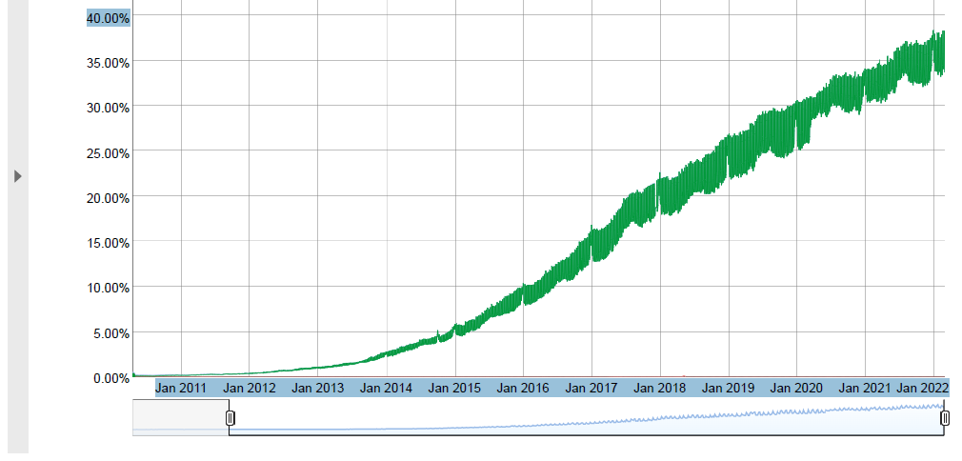
Adoption of IPv6 – less than 40%

Slide 14
Assigning IP addresses
Every device (real or virtual) on the internet is assigned an IP address.
VMs
Containers
Internet of Things (IoT) – toasters, refrigerators, thermostats, etc

Slide 15
ICANN
The Internet Corporation for Assigned Names and Numbers (ICANN) is a non-profit organization with the responsibility for assigning domain names and IP addresses.
It allocates addresses in large blocks (X.0.0.0 through X.255.255.255) to regional entities.
A recipient of one these large blocks is authorized by ICANN to split up the block and further allocate the addresses in smaller blocks.

Slide 16
IP addresses
Your ISP has been allocated a collection of IP addresses
Each address is either public or private
A public IP address is available from anywhere in the network
A private IP address is restricted to a local network.
Each address is either static or dynamic
A static IP address is assigned permanently to a device
A dynamic IP address is temporary.

Slide 17
Private IP addresses
The following addresses are always private
10.0.0.0 | to | 10.255.255.255
172.16.0.0 | to | 172.31.255.255
192.168.0.0 | to | 192.168.255.255
127.0.0.1 is reserved for “localhost”
A message sent to localhost will be delivered back to sender. Allows for testing.

Slide 18
Dynamic IP addresses
Your ISP has been allocated a collection of IP addresses.
It assigns one to your device when you log in and it remains until you log off.
The Dynamic Host Configuration Protocol (DHCP) is used to assign an IP address to your device.
Your local network has a DHCP server. Your device broadcasts a request which is recognized by the DHCP server.
The DHCP server manages a pool of IP addresses and assigns one to your device

Slide 19
Composing a message
Each message consists of a header and a payload.
Suppose you wish to send a HTTP message over TCP/IP, how is wrapped?
The HTTP message is the payload of the TCP message
The TCP message is the payload of the IP message

Slide 20
Mail Analogy
Message to individual wrapped in an envelope (App level protocol)
That envelope is enclosed in an envelope with house number (TCP)
That envelope is, in turn, enclosed in an envelope with post office address (IP)
Outer envelope arrives at a post office
Opened to expose intermediate envelope which is delivered to a house
Opened to expose inner envelope which is delivered to an individual
Individual opens envelope to get message

Slide 21
Message Format
An IP message has a header and a payload. The header includes
IP address of the source
IP address of the destination

Slide 22
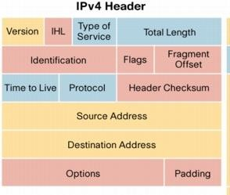
Internet Protocol packet structure (v4)

Slide 23
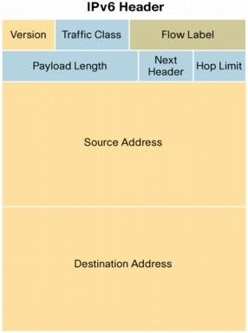

Internet Protocol packet structure (v6)

Slide 24
Message Structure
A device creates a message by creating a header and adding a payload and placing it on the network.
IP_{A} sends a message to IP_{B} and it consists of header+payload
Recipient responds to source address in header

Slide 25
Manipulating messages
When IP_{A} sends message to IP_{B}, i.e., IP_{A}+payload -> IP_{B} , a gateway can make it look like the message comes from the gateway. i.e. IP_{gateway}+payload -> IP_{B}
In this case the gateway must have a mechanism to manage the response from IP_{B}

Slide 26
Discussion questions
Why has the adoption of IPv6 been so slow?
Is the DHCP server on your local network or on the ISP’s network?
What are some mechanisms a gateway can use to return a response to the original source?

Slide 27
Outline
Introduction
IP addresses
DNS
Ports
Bridged and NAT networks
TCP
Structuring your network

Slide 28
Domain Name System (DNS)
IP addresses are too cumbersome for people to use.
Uniform Resource Locators (URLs) are used to identify devices
A directory service is used to map from names to IP addresses (think of a phone book)
The Domain Name System (DNS) is a global directory service for VMs.
DNS is managed by ICANN.

Slide 29

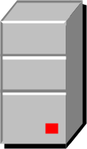

Domain Name System Server
Client sends URL to DNS server
DNS server takes as input a URL and returns an IP address
Client uses IP address to send message to a site
Website.com
123.45.67.89
123.45.67.89
DNS server

Slide 30
Complications
In reality, messages being transmitted from one computer to another is more complicated.
The picture showed a single DNS server.
There are multiple DNS servers
There is a hierarchy of DNS servers.
The picture showed a single line from client to server.
There is a network of routers to transmit messages
Shares load

Slide 31
DNS Hierarchy
Consider URL www.mse.isri.cmu.edu
If one server held all DNS -> IP mappings, it would both get overloaded and hold over 200 million mappings.
DNS is arranged as a hierarchy.

Slide 32
Finding www.mse.isri.cmu.edu
Begin with “root server”. There are 13 root servers with known IP addresses. These are built into the router. (https://www.iana.org/domains/root/servers)
Access root server to get IP address of the .edu DNS server
The .edu DNS server has the IP of the .cmu.edu DNS server and so forth.
Eventually you get to a DNS server that is under local control
This allows MSE to change the IP of the various local DNSs without changing anything up the hierarchy.

Slide 33
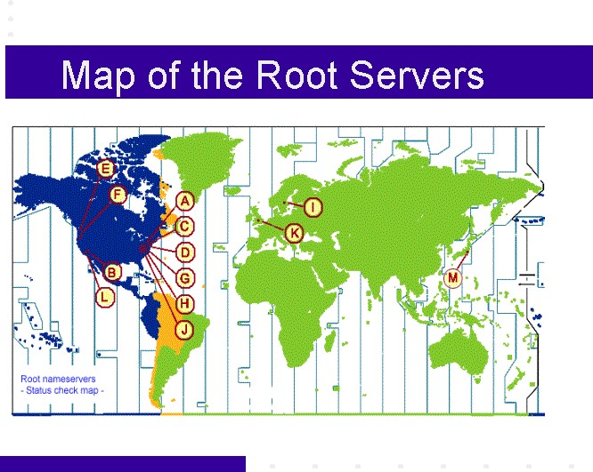

Slide 34
DNS system is tightly secured
If an attacker could manipulate a DNS server, they could disrupt the portion of the internet specified by that server.
Root servers have extensive physical and internet security and other servers also are secured.
Means that changing IP addresses within a DNS server is restricted to authorized personnel.
We will discuss DNSSEC later. This is another means of securing the DNS system.

Slide 35
Time to Live
Clients do not access a DNS server for every request. It would generate too much internet traffic.
Associated with each DNS entry is a Time To Live (TTL).
This is also called a “Refresh Interval” in the DNS resource record called Start of Authority (SOA).
The client or the ISP caches the IP addresses associated with DNS entries and these entries are valid for the TTL.
This is distinct from the TTL listed in the IPv4 packet header.

Slide 36
TTL settings
The value of the TTL depends where in the hierarchy the record exists.
High in the hierarchy (authorative servers), TTLs are set to seven days since the likelihood of there being a change is low.
Records under local control can have their TTLs set low (~seconds)
Minimum is 1 second.

Slide 37
Client (browser) perspective on DNS, URL, and TTL
Client gets ip addresses of an edu server from root
TTL is 7 days
Client gets IP addresses of a server cmu from edu server
TTL is 7 days
Client gets ip addresses of isri from cmu server
TTL is 12 hours
Client gets ip address of mse server from isri server
TTL is 6 hours
Client gets ip address of www server from mse server
TTL is 5 minutes
Times are estimates, actual values are probably different

Slide 38
Using DNS to Handle Overload and Failure
The DNS server may return a list of IP addresses for a given URL
By rotating the list (first time 1,2,3 -- second time 2,3,1 -- etc) load is distributed among different instances of given URL
Instance may have failed. Browser will retry several times but having a list gives the browser a fall back IP.

Slide 39
Discussion questions
Why is DNS primarily for VMs and not containers?
What is the sequence of IPs from root to your device?

Slide 40
Outline
Introduction
IP addresses
DNS
Ports
Bridged and NAT networks
TCP
Structuring your network

Slide 41
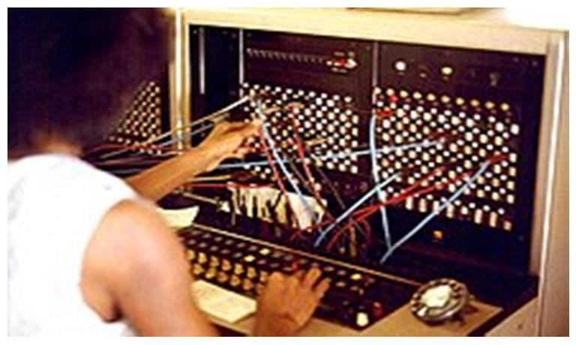
Getting a message to a service
An IP address will get a message to a VM or container.
It still must be routed to a service to have effect.
A service listens for messages on a port.
The analogy is with an old-fashioned telephone switchboard.
A call comes in to a hotel on the hotel’s number.
The operator answers and asks, “what room?”
A cord is plugged into the room receptacle
The telephone rings in that room and the occupant of the room can then talk on the phone.

Slide 42
Port numbers
Each service listens on one or more ports.
Some port numbers are assigned by ICANN
22 for Secure Shell (SSH)
25 for mail service
53 for DNS
80 for HTTP (hypertext transfer protocol)
443 for HTTPS (secure hypertext transfer protocol)
Other port numbers are by agreement with sender and recipient.
Operating system on IP destination will forward message to specified port.

Slide 43
Message intended for a VM
Host computer
Each VM has its own OS
Each OS will manage ports in its VM
Apps
Apps
Apps
OS1
OS2
OS3
VM1
VM2
VM3
Hypervisor

Slide 44
Message intended for a container
Containers share OS
Port collision can occur
E.g suppose App1 and App2 are web servers
They both listen on port 80
OS does not know how to route a message.
App1
App2
App3
Container run time engine
Host Operating System
Bare metal or Virtual Machine

Slide 45
Port forwarding
Two services listening on the same port may cause a message destined for one application to be sent to another.
Port forwarding tells a routing computer that a message specified for one port should actually be delivered to another.

Slide 46
Discussion questions
What are some other dedicated port numbers?
What port numbers are not assigned?

Slide 47
Outline
Introduction
IP addresses
DNS
Ports
Bridged and NAT networks
TCP
Structuring your network

Slide 48
Bridged networks
Host computer
Recall that booting a VM connects it to a network adapter on the host computer.
A bridged network has all of the VMs connected to the host network adapter.
Apps
OS1
Apps
OS2
Apps
OS3
VM1
VM2
VM3
Hypervisor

Slide 49
Bridged network IP management
Each VM on the bridged network has its own IP address.
The IP address can be public or private.
The VMs on a bridged network may or may not be behind a gateway.
Public IP addresses can be directly accessed from the internet.

Slide 50
NAT network
NAT acts as gateway for VM IPs
VM IPs are all private
NAT is connected to host network adapter
NAT can act as a firewall

Slide 51
Discussion questions
The slides show bridged networks for Type 1 hypervisors and NAT networks for Type 2 hypervisors. Is this necessary?
The slides show how messages are routed for VMs. What are the corresponding figures for containers?

Slide 52
Outline
Introduction
IP addresses
DNS
Ports
Bridged and NAT networks
TCP
Structuring your network

Slide 53
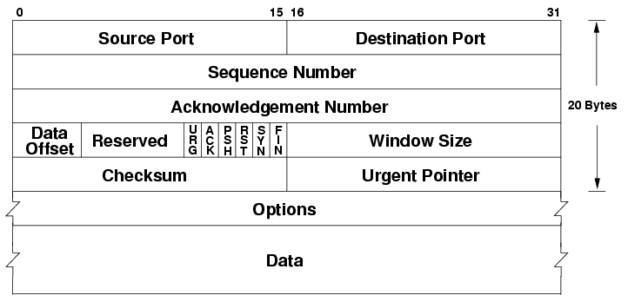
TCP
Transmission Control Protocol (TCP) is a layer 2 (transport) protocol
It is commonly wrapped as the payload in an IP message.
TCP header

Slide 54
Features of TCP
Reliable. Recipient must acknowledge receipt or message is assumed not delivered.
Ordered. Header has sequence number in cases messages get out of order in transit.
Error checking. A checksum is used to detect errors in transmission.
Header includes source port and destination port.
Destination port tells recipient OS how to route message. Destination service is listening on destination port.
Source port tells destination how to respond.
Both destination and source ports can be modified in transit.

Slide 55
Discussion questions
Is it possible to use TCP on an internet layer protocol other than IP?
How long does the sender wait for an acknowledgement (usually)?

Slide 56
Outline
Introduction
IP addresses
DNS
Ports
Bridged and NAT networks
TCP
Structuring your network

Slide 57
Subnets
A subnet is a group of devices that are connected directly to each other. Messages between devices on a subnet do not pass through an IP router.
A subnet is created within an address space by making the first portion of the IP address (the subnet prefix) the same for all the devices in the subnet. The remaining portion of the IP address will identify which device in the subnet a message is sent to.
Reasons for creating a subnet
network performance. A subnet simplifies the work of a router.
security. A firewall for the subnet can verify that accesses to the resources on that subnet are allowed.

Slide 58
Partitioning your network
Firewalls are used to protect one portion of your network from another. E.g. financial systems might be on separate subnet to limit access from other internal systems.
Firewalls are also used to create a “Demilitarized Zone (DMZ)”
DMZs are used to allow internet access to some servers and not to your Intranet.
Web servers can be made externally visible.
VPN servers can be made externally visible

Slide 59
DMZ
DMZ has rules to route messages for certain ports to servers in the DMZ

Slide 60
Tunneling
One server in the DMZ supports Virtual Private Network (VPN).
VPN allows devices on the internet access to the intranet.
You are working from home and wish to access your intranet.
You log in to the VPN server and it verifies your credentials by passing them to the authentication server in the intranet.
Subsequent messages are sent using a tunneling protocol

Slide 61
Tunneling protocol
A tunneling protocol encrypts your entire message, including the IP header that you created for the message, and puts it into the payload portion of a TCP message.
The TCP messages is routed to the VPN server.
The VPN server removes the TCP payload and decrypts your message, including the IP header that you created

Slide 62
Tunneling protocol
The message is then sent to the intranet.
If your destination IP address is a device within your organization, the message is delivered over your organization’s intranet.
If your destination IP address is outside your organization, your message will be sent out to the internet through your organization’s NAT and firewall.

Slide 63
Discussion questions
Create (or find) a map of your organization’s intranet. How many firewalls are there? What subnets are protected by the firewalls?
In addition to routing rules based on port number, what other rules are there in an internet facing firewall?

Slide 64
END OF CHAPTER 3

